Slide 1
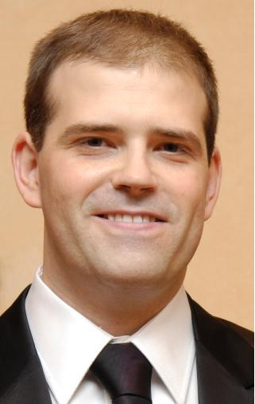
Introduction:
Jaume Roset
Professional Coach, Trainer, Consultant
BIO:
Before working as a coach, I have been working for 13 years in big consulting companies (IBM, Price Waterhouse Coopers). I have worked as a Senior Consultant and Senior Project Manager. I have delivered transformation projects in the Supply Chain area in the retail and heatlh care sector (sector leader companies). I also have strong experience in IT implementation projects (SAP and others). My experience includes managing teams up to 15 people.
Since 2009 I work as a professional coach. I have my own coaching business, where I work with Career transitions, Career Promotions, life purpose and personal dreams. I also work as a coach and trainer Freelance for differentecompanies.
I teach logistics and Project Management at Universitat Politécnica de Catalunya (spanish public university)
I’m a dreamchaser. I’m absolutely convinced that follow your bliss and your dreams is the smartest decission a person can take. And that’s my philosophy with my clients
Jaume Roset
Professional Coach

